Slide 1
Lecture 2: Regression
CS 550: Machine Learning
Instructor: Dr. Gagan Raj Gupta

Slide 2
Today’s Class
Linear Regression problems
Loss Functions for Regression
Stability Issues in matrix operations
Regularization to avoid over-fitting
Different regularization objectives
SGD to solve Linear Regression

Slide 3
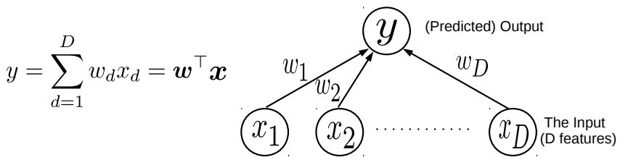

Linear Models
3
Consider learning to map an input $x∈ℝ^{D}$ to the corresponding (say real-valued) output $y$
Assume the output to be a linear weighted combination of the $D$ input features
This simple model can be used for Linear Regression
This simple model can also be used as a “building block” for more complex models
Even classification (binary/multiclass/multi-output/multi-label) and various other ML/deep learning models
Even unsupervised learning problems (e.g., dimensionality reduction models)
This defines a linear model with $D$ parameters given by a “weight vector” $w=[w_{1},w_{2},…,w_{D}]$
Each of these weights have a simple interpretation: $w_{d}$ is the “weight” or importance of the $d^{th}$ feature in making this prediction
The “optimal” weights are unknown and have to be learned by solving an optimization problem, using some training data

Slide 4
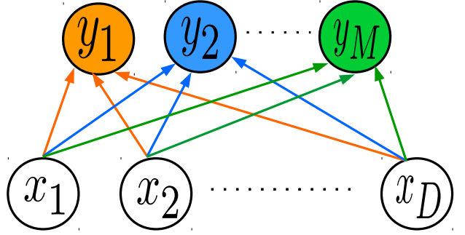
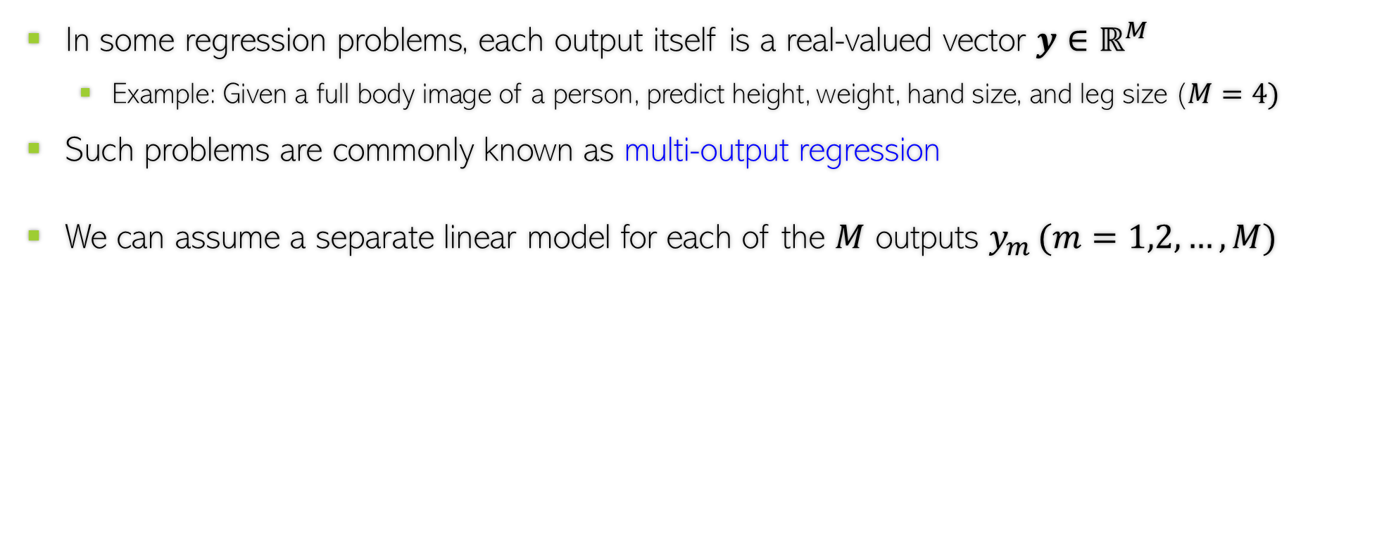
Simple Linear Models as Building Blocks
4
In some regression problems, each output itself is a real-valued vector $y∈ℝ^{M}$
Example: Given a full body image of a person, predict height, weight, hand size, and leg size ($M=4)$
Such problems are commonly known as multi-output regression
We can assume a separate linear model for each of the $M$ outputs $y_{m }(m=1,2,…,M)$
Now each $w_{m}$ $∈ℝ^{D}$ is a D-dim weight vector for predicting the $m^{th}$output
$$y_{m}= w_{m}^{⊤}x$$
$$y=Wx$$
Here $W$ is an MxD weight matrix with its $m^{th}$ row containing $w_{m}$
$$w_{1}^{⊤}$$
Note: Learning $M$ separate models may not be ideal these multiple outputs are somewhat correlated with each other. But this model can be extended to handle such situation (techniques are a bit advanced to be discussed right now – but if curious, you may look up more about multitask learning techniques)
Learning this model will require us to learn this weight matrix (or equivalently, the $M$ weight vectors)
$$w_{2}^{⊤}$$
$$w_{M}^{⊤}$$
$$x$$
$$y$$
$$W$$

Slide 5

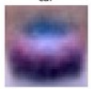
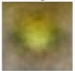
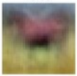
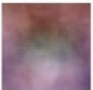
Simple Linear Models as Building Blocks
5
Linear models are also used in multiclass classification problems
Assuming $K$ classes, we can assume the following model
Can think of $w_{k}^{⊤}x$ as the score of the input for the $k^{th}$ class
Once learned (using some optimization technique), these $K$ weight vectors (one for each class) can sometimes have nice interpretations, especially when the inputs are images
$$y= {argmax}_{k∈\{1,2,…,K\}} w_{k}^{⊤}x$$
The learned weight vectors of each of the 4 classes visualized as images – they kind of look like a “template” of what the images from that class should look like
These images sort of look like class prototypes if I were using LwP ☺
$$w_{car}$$
$$w_{frog}$$
$$w_{horse}$$
$$w_{cat}$$
Yeah, “sort of”. ☺
No wonder why LwP (with Euclidean distances) acts like a linear model. ☺
That’s why the dot product of each of these weight vectors with an image from the correct class will be expected to be the largest

Slide 6
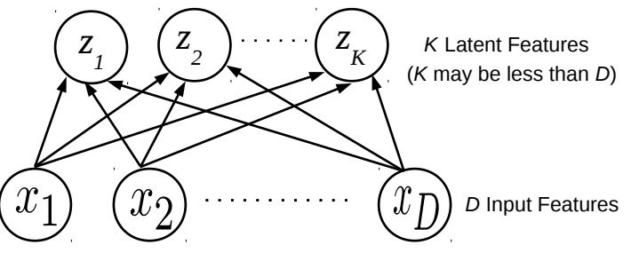
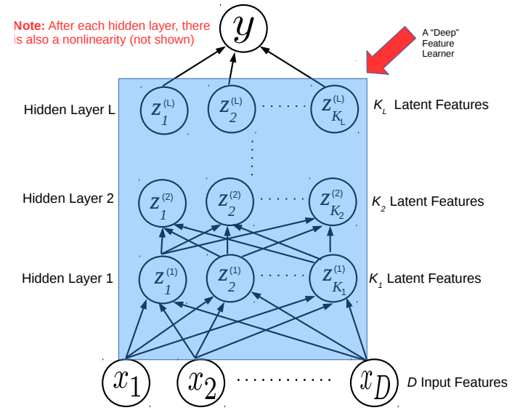
Simple Linear Models as Building Blocks
6
Linear models are building blocks for dimensionality reduction methods like PCA
Linear models are building blocks for even deep learning model (each layer is like a multi-output linear model, followed by a nonlinearity)
This looks very similar to the multi-output model, except that the values of the $K$ latent features are not known and have to be learned
In a deep learning model, each layer learns a latent feature representation of the inputs using a model like a multi-output linear model, followed by a nonlinearity
The last (output) layer can have one or more outputs
More on this when we discuss deep learning later

Slide 7
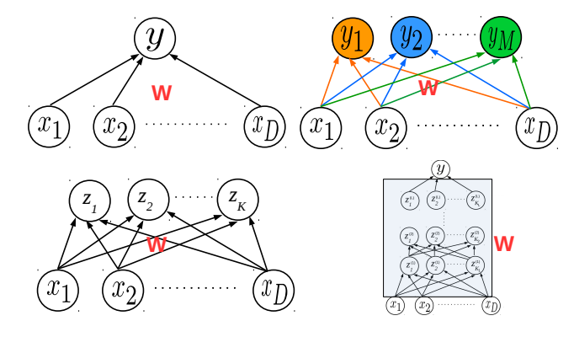
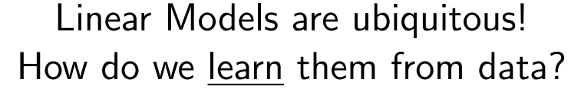
Learning Linear Models
7

Slide 8
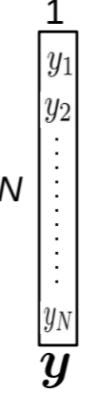
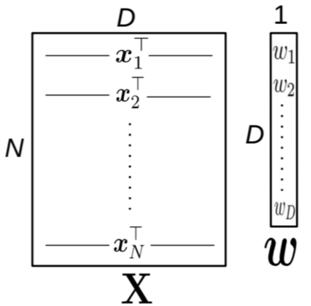
Linear Regression
8
Given: Training data with $N$ input-output pairs ${{\{(x}_{n},y_{n})\}}_{n=1}^{N}$, $x_{n}∈ℝ^{D}$, $y_{n}∈ℝ$
Goal: Learn a model to predict the output for new test inputs
Assume the function that approximates the I/O relationship to be a linear model
Let’s write the total error or “loss” of this model over the training data as
$$y_{n}≈f\left(x_{n}\right)= w^{⊤}x_{n} (n=1,2,…,N)$$
Can also write all of them compactly using matrix-vector notation as $y≈Xw$
Goal of learning is to find the $w$ that minimizes this loss + does well on test data
$L\left(w\right)= \sum_{n=1}^{N}{ℓ(y_{n}, }$ $w^{⊤}x_{n}$)
$ℓ(y_{n},w^{⊤}x_{n})$ measures the
prediction error or “loss” or “deviation” of the model on a single training input ${(x}_{n},y_{n})$
Unlike models like KNN and DT, here we have an explicit problem-specific objective (loss function) that we wish to optimize for

Slide 9
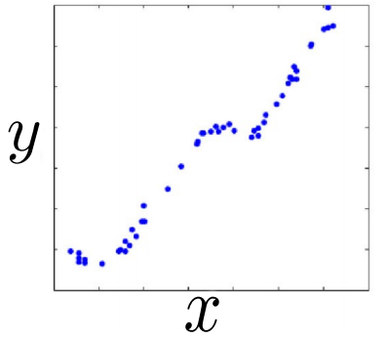
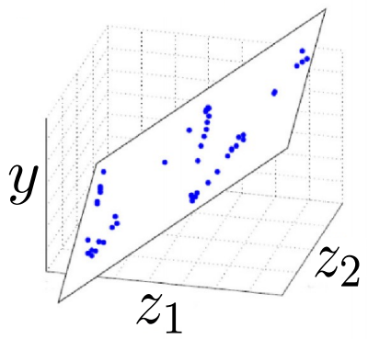
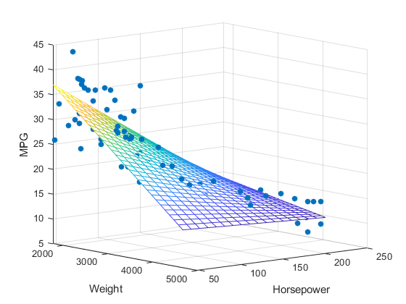

Linear Regression: Pictorially
9
Linear regression is like fitting a line or (hyper)plane to a set of points
The line/plane must also predict outputs the unseen (test) inputs well
$$\left[\begin{aligned}z_{1} \\ z_{2}\end{aligned}\right]=φ(x)$$
What if a line/plane doesn’t model the input-output relationship very well, e.g., if their relationship is better modeled by a nonlinear curve or curved surface?
Original (single) feature
Nonlinear curve needed
Two features
Can fit a plane (linear)
(Output $y$)
(Output $y$)
Do linear models become useless in such cases?
No. We can even fit a curve using a linear model after suitably transforming the inputs
$$y≈w^{⊤}φ(x)$$
Input $x$ (single feature)
(Feature 2)
(Feature 1)
The transformation $φ\left(.\right)$ can be predefined or learned (e.g., using kernel methods or a deep neural network based feature extractor). More on this later

Slide 10
Loss Functions for Regression
10
Choice of loss function usually depends on the nature of the data. Also, some loss functions result in easier optimization problem than others
Many possible loss functions for regression problems
Squared loss
Loss
$${(y_{n}−f(x_{n}))}^{2}$$
Absolute loss
Loss
$${|y}_{n}−f\left(x_{n}\right)|$$
Very commonly used for regression. Leads to an easy-to-solve optimization problem
Grows more slowly than squared loss. Thus better suited when data has some outliers (inputs on which model makes large errors)
${y_{n}− f(x}_{n}$)
${y_{n}− f(x}_{n}$)
Loss
Huber loss
Loss
$${|y}_{n}−f\left(x_{n}\right)|−ε$$
Squared loss for small errors (say up to $δ$); absolute loss for larger errors. Good for data with outliers
$ε$-insensitive loss
(a.k.a. Vapnik loss)
Note: Can also use squared loss instead of absolute loss
Zero loss for small errors (say up to $ε$); absolute loss for larger errors
$$−δ$$
$$δ$$
${y_{n}− f(x}_{n}$)
$$−ε$$
$$ε$$
${y_{n}− f(x}_{n}$)

Slide 11
Linear Regression with Squared Loss
11
In matrix-vector notation, can write it compactly as ${\left\|y−Xw\right\|}_{2}^{2}={(y−Xw)}^{⊤}(y−Xw$)
In this case, the loss func will be
Let us find the $w$that optimizes (minimizes) the above squared loss
We need calculus and optimization to do this!
The LS problem can be solved easily and has a closed form solution
$L\left(w\right)=$ $\sum_{n=1}^{N}{{(y_{n}−w^{⊤}x_{n})}^{2}}$
The “least squares” (LS) problem Gauss-Legendre, 18th century)
Closed form solutions to ML problems are rare.
$w_{LS}$= ${\text{arg} \text{min}}_{w} L\left(w\right)={\text{arg} \text{min}}_{w}\sum_{n=1}^{N}{{(y_{n}−w^{⊤}x_{n})}^{2}}$
$w_{LS}$= ${(\sum_{n=1}^{N}{x_{n} x_{n}^{⊤}) }}^{−1}(\sum_{n=1}^{N}{y_{n}x_{n}})$
$${=(X^{⊤}X)}^{−1}X^{⊤}y$$
$D×D$ matrix inversion – can be expensive. Ways to handle this. Will see later

Slide 12
Proof: A bit of calculus/optim. (more on this later)
12
We wanted to find the minima of $L\left(w\right)=\sum_{n=1}^{N}{{(y_{n}−w^{⊤}x_{n})}^{2}}$
Let us apply basic rule of calculus: Take first derivative of $L\left(w\right)$ and set to zero
Using the fact $\frac{∂}{∂w}$ $w^{⊤}x_{n}=x_{n}$, we get $\sum_{n=1}^{N}{2\left(y_{n}−w^{⊤}x_{n}\right)x_{n}=0}$
To separate $w$ to get a solution, we write the above as
Chain rule of calculus
$\frac{∂L\left(w\right)}{∂w}=\frac{∂}{∂w}$ $\sum_{n=1}^{N}{{(y_{n}−w^{⊤}x_{n})}^{2}}=\sum_{n=1}^{N}{2\left(y_{n}−w^{⊤}x_{n}\right)\frac{∂}{∂w}}\left(y_{n}−w^{⊤}x_{n}\right)=0$
Partial derivative of dot product w.r.t each element of $w$
Result of this derivative is $x_{n}$ - same size as $w$
$$\sum_{n=1}^{N}{2x_{n}\left(y_{n}−x_{n}^{⊤}w\right)=0}$$
$$\sum_{n=1}^{N}{y_{n}x_{n}−x_{n}x_{n}^{⊤}w=0}$$
$w_{LS}$= ${(\sum_{n=1}^{N}{x_{n} x_{n}^{⊤}) }}^{−1}(\sum_{n=1}^{N}{y_{n}x_{n}})$
$${=(X^{⊤}X)}^{−1}X^{⊤}y$$

Slide 13
Problem(s) with the Solution!
13
We minimized the objective $L\left(w\right)=$ $\sum_{n=1}^{N}{{(y_{n}−w^{⊤}x_{n})}^{2}}$ w.r.t. $w$ and got
Problem: The matrix $X^{⊤}X$ may not be invertible
This may lead to non-unique solutions for $w_{opt}$
Problem: Overfitting since we only minimized loss defined on training data
Weights $w=[w_{1},w_{2},…,w_{D}]$ may become arbitrarily large to fit training data perfectly
Such weights may perform poorly on the test data however
One Solution: Minimize a regularized objective $L\left(w\right)+$ $λ R\left(w\right)$
The reg. will prevent the elements of $w$ from becoming too large
Reason: Now we are minimizing training error + magnitude of vector $w$
$w_{LS}$= ${(\sum_{n=1}^{N}{x_{n} x_{n}^{⊤}) }}^{−1}(\sum_{n=1}^{N}{y_{n}x_{n}})$
$${=(X^{⊤}X)}^{−1}X^{⊤}y$$
$R\left(w\right)$is called the Regularizer and measures the “magnitude” of $w$
$λ≥0$ is the reg. hyperparam. Controls how much we wish to regularize (needs to be tuned via cross-validation)

Slide 14
Regularized Least Squares (a.k.a. Ridge Regression)
Recall that the regularized objective is of the form $L_{reg}(w)= L\left(w\right)+λ R\left(w\right)$
One possible/popular regularizer: the squared Euclidean ($ℓ_{2}$ squared) norm of $w$
With this regularizer, we have the regularized least squares problem as
Proceeding just like the LS case, we can find the optimal $w$ which is given by
$$R\left(w\right)= {\left\|w\right\|}_{2}^{2}= w^{⊤}w$$
Look at the form of the solution. We are adding a small value $λ$ to the diagonals of the DxD matrix $X^{⊤}X$(like adding a ridge/mountain to some land)
$w_{ridge}\text{=} {\text{arg} \text{min}}_{w} L\left(w\right)$ + $λ R\left(w\right)$
$${\text{= }\text{arg} \text{min}}_{w}\sum_{n=1}^{N}{{(y_{n}−w^{⊤}x_{n})}^{2}}+λw^{⊤}w$$
Why is the method called “ridge” regression
$w_{ridge}$= ${(\sum_{n=1}^{N}{x_{n} x_{n}^{⊤}+λI_{D}) }}^{−1}(\sum_{n=1}^{N}{y_{n}x_{n}})$
$${=(X^{⊤}X+λI_{D})}^{−1}X^{⊤}y$$

Slide 15
A closer look at $ℓ_{2}$ regularization
Remember – in general, weights with large magnitude are bad since they can cause overfitting on training data and may not work well on test data
The regularized objective we minimized is
Minimizing $L_{reg}\left(w\right)$w.r.t. $w$ gives a solution for $w$ that
Keeps the training error small
Has a small $ℓ_{2}$ squared norm $w^{⊤}w$ = $\sum_{d=1}^{D}{w_{d}^{2}}$
Small entries in $w$ are good since they lead to “smooth” models
$$L_{reg}\left(w\right)=\sum_{n=1}^{N}{{(y_{n}−w^{⊤}x_{n})}^{2}}+λw^{⊤}w$$
Good because, consequently, the individual entries of the weight vector $w$ are also prevented from becoming too large
Not a “smooth” model since its test data predictions may change drastically even with small changes in some feature’s value
A typical $w$ learned without $ℓ_{2}$ reg.
$$x_{n}=$$
1.2
0.5
2.4
0.3
0.8
0.1
0.9
2.1
$$y_{n}=0.8$$
3.2
1.8
1.3
2.1
10000
2.5
3.1
0.1
$$x_{m}=$$
$$y_{m}=100$$
1.2
0.5
2.4
0.3
0.8 $+ ε$
0.1
0.9
2.1
Just to fit the training data where one of the inputs was possibly an outlier, this weight became too big. Such a weight vector will possibly do poorly on normal test inputs
Exact same feature vectors only differing in just one feature by a small amount
Very different outputs though (maybe one of these two training ex. is an outlier)

Slide 16
Other Ways to Control Overfitting
Note that optimizing loss functions with such regularizers is usually harder than ridge reg. but several advanced techniques exist (we will see some of those later)
Use a regularizer $R\left(w\right)$ defined by other norms, e.g.,
Use non-regularization based approaches
Early-stopping (stopping training just when we have a decent val. set accuracy)
Dropout (in each iteration, don’t update some of the weights)
Injecting noise in the inputs
$ℓ_{1}$ norm regularizer
Use them if you have a very large number of features but many irrelevant features. These regularizers can help in automatic feature selection
$${\left\|w\right\|}_{1}= \sum_{d=1}^{D}{|w_{d}|}$$
When should I used these regularizers instead of the $ℓ_{2}$ regularizer?
$${\left\|w\right\|}_{0}=\#nnz(w)$$
Using such regularizers gives a sparse weight vector $w$ as solution
sparse means many entries in $w$ will be zero or near zero. Thus those features will be considered irrelevant by the model and will not influence prediction
Automatic feature selection? Wow, cool!!!
But how exactly?
$ℓ_{0}$ norm regularizer (counts number of nonzeros in $w$
All of these are very popular ways to control overfitting in deep learning models. More on these later when we talk about deep learning

Slide 17
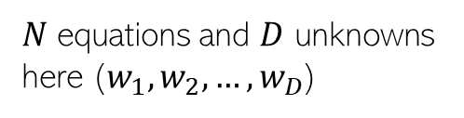
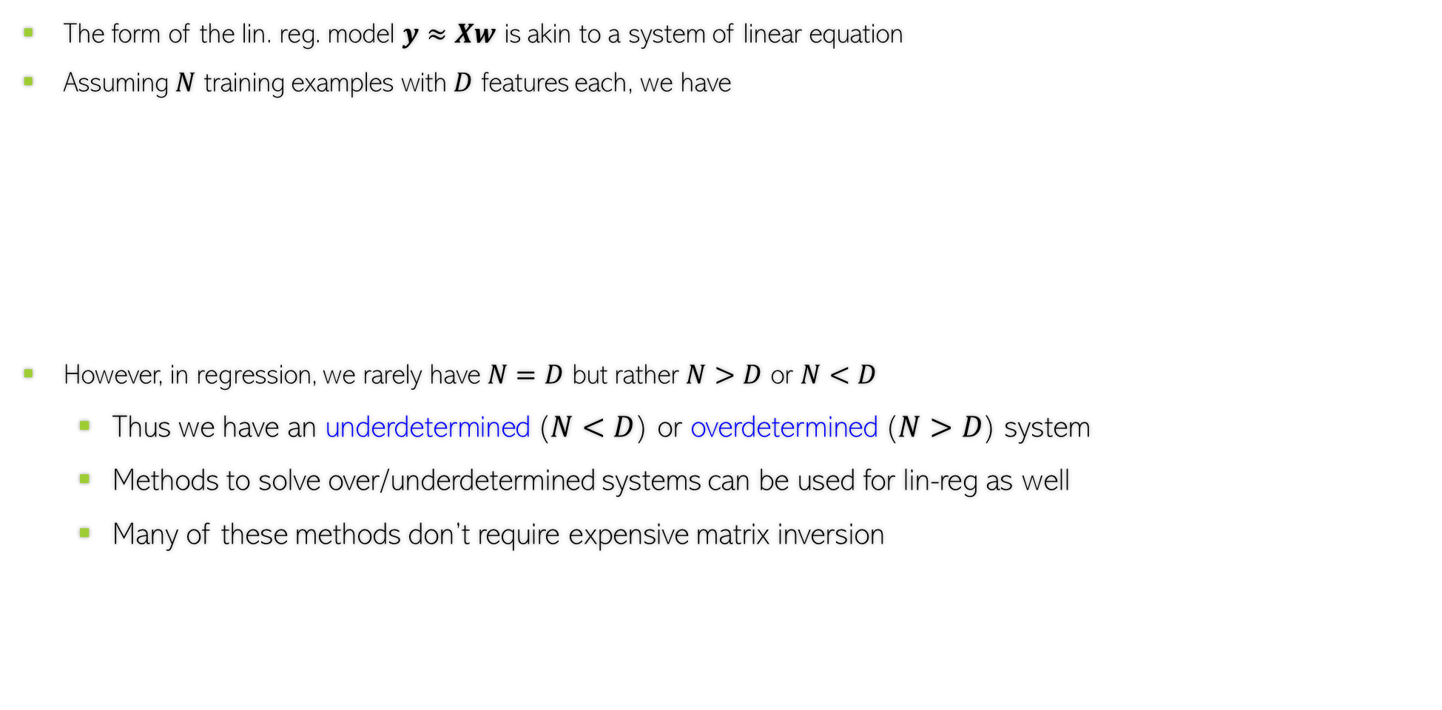
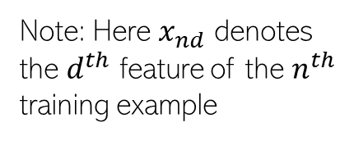

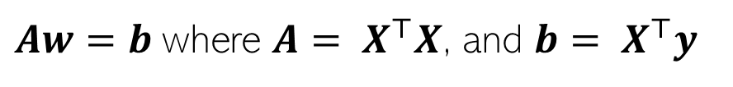


Linear Regression as Solving System of Linear Eqs
The form of the lin. reg. model $y≈Xw$ is akin to a system of linear equation
Assuming $N$ training examples with $D$ features each, we have
However, in regression, we rarely have $N=D$ but rather $N>D$ or $N<D$
Thus we have an underdetermined ($N<D$) or overdetermined ($N>D$) system
Methods to solve over/underdetermined systems can be used for lin-reg as well
Many of these methods don’t require expensive matrix inversion
First training example:
$$y_{1}=x_{11}w_{1}+x_{12}w_{2}+ …+x_{1D}w_{D}$$
Second training example:
$$y_{2}=x_{21}w_{1}+x_{22}w_{2}+ …+x_{2D}w_{D}$$
Note: Here $x_{nd}$ denotes the $d^{th}$ feature of the $n^{th}$ training example
$N$ equations and $D$ unknowns here ($w_{1},w_{2},…,w_{D}$)
N-th training example:
$$y_{N}=x_{N1}w_{1}+x_{N2}w_{2}+ …+x_{ND}w_{D}$$
Now solve this!
Solving lin-reg
as system of lin eq.
$$w{=(X^{⊤}X)}^{−1}X^{⊤}y$$
$Aw=b$ where ${A= X}^{⊤}X$, and ${b= X}^{⊤}y$
System of lin. Eqns with $D$ equations and $D$ unknowns

Slide 18

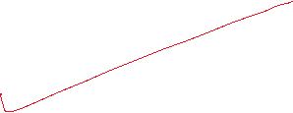

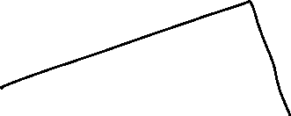


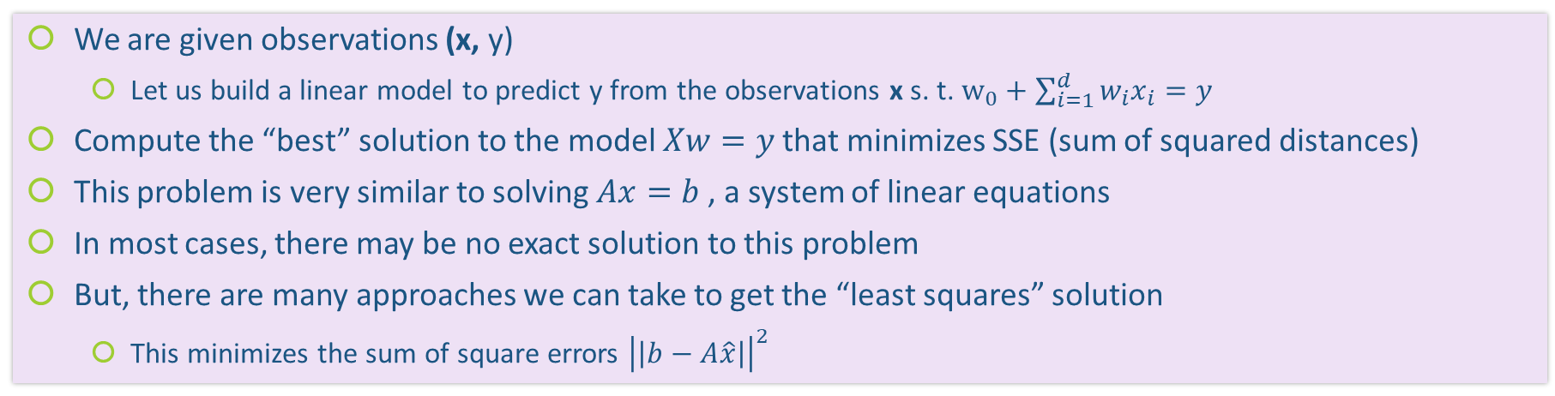

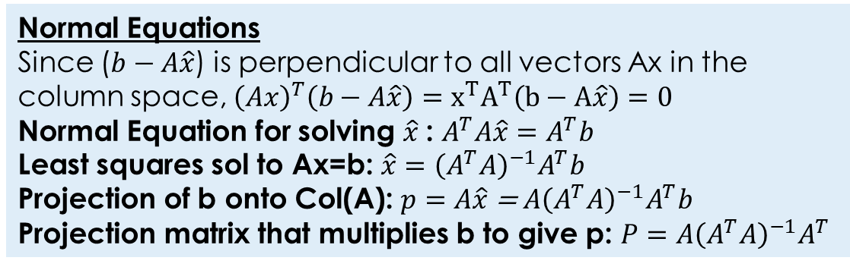


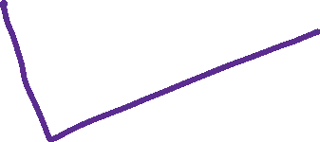


Linear Regression (Problem setup)
We are given observations (x, y)
Let us build a linear model to predict y from the observations x s. t. $w_{0}+\sum_{i=1}^{d}{w_{i}x_{i}=y}$
Compute the “best” solution to the model $Xw=y$that minimizes SSE (sum of squared distances)
This problem is very similar to solving $Ax=b$ , a system of linear equations
In most cases, there may be no exact solution to this problem
But, there are many approaches we can take to get the “least squares” solution
This minimizes the sum of square errors ${\left|\left|b−A\hat{x}\right|\right|}^{2}$
Normal Equations
Since ($b−A\hat{x}$) is perpendicular to all vectors Ax in the column space, ${\left(Ax\right)}^{T}\left(b−A\hat{x}\right)=x^{T}A^{T}\left(b−A\hat{x}\right)=0$
Normal Equation for solving $\hat{x}$: $A^{T}A\hat{x}=A^{T}b$
Least squares sol to Ax=b: $\hat{x}={\left(A^{T}A\right)}^{−1}A^{T}b$
Projection of b onto Col(A): $p=A\hat{x}$ = $A{\left(A^{T}A\right)}^{−1}A^{T}b$
Projection matrix that multiplies b to give p: $P=A{\left(A^{T}A\right)}^{−1}A^{T}$

Slide 19




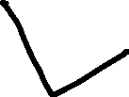



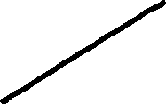
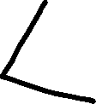
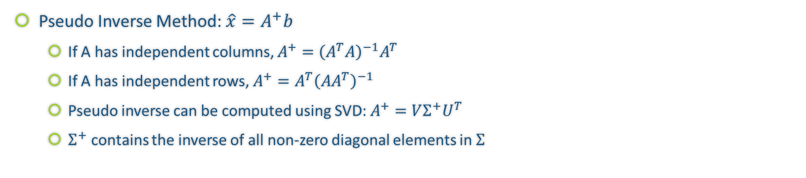

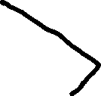



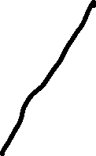

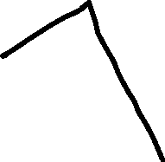



Pseudo Inverse Method
Pseudo Inverse Method: $\hat{x}=A^{+}b$
If A has independent columns, $A^{+}={\left(A^{T}A\right)}^{−1}A^{T}$
If A has independent rows, $A^{+}=A^{T}{\left(AA^{T}\right)}^{−1}$
Pseudo inverse can be computed using SVD: $A^{+}=VΣ^{+}U^{T}$
$Σ^{+}$ contains the inverse of all non-zero diagonal elements in $Σ$

Slide 20

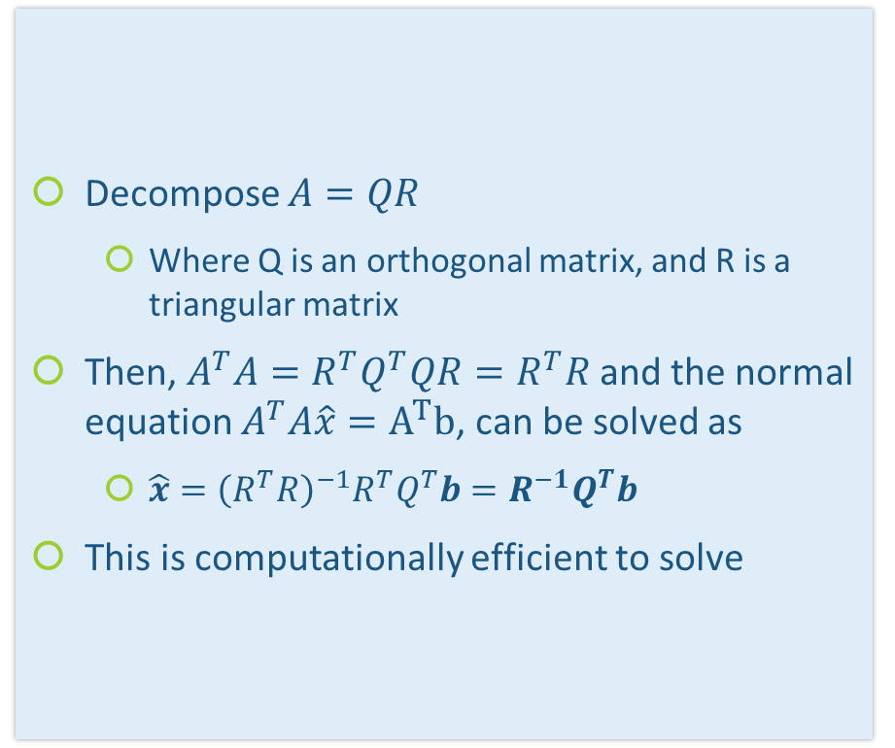

QR (Gram-Schmidt) Method
Decompose $A=QR$
Where Q is an orthogonal matrix, and R is a triangular matrix
Then, $A^{T}A=R^{T}Q^{T}QR=R^{T}R$and the normal equation $A^{T}A\hat{x}=A^{T}b$, can be solved as
$\hat{x}={\left(R^{T}R\right)}^{−1}R^{T}Q^{T}b=R^{−1}Q^{T}b$
This is computationally efficient to solve

Slide 21
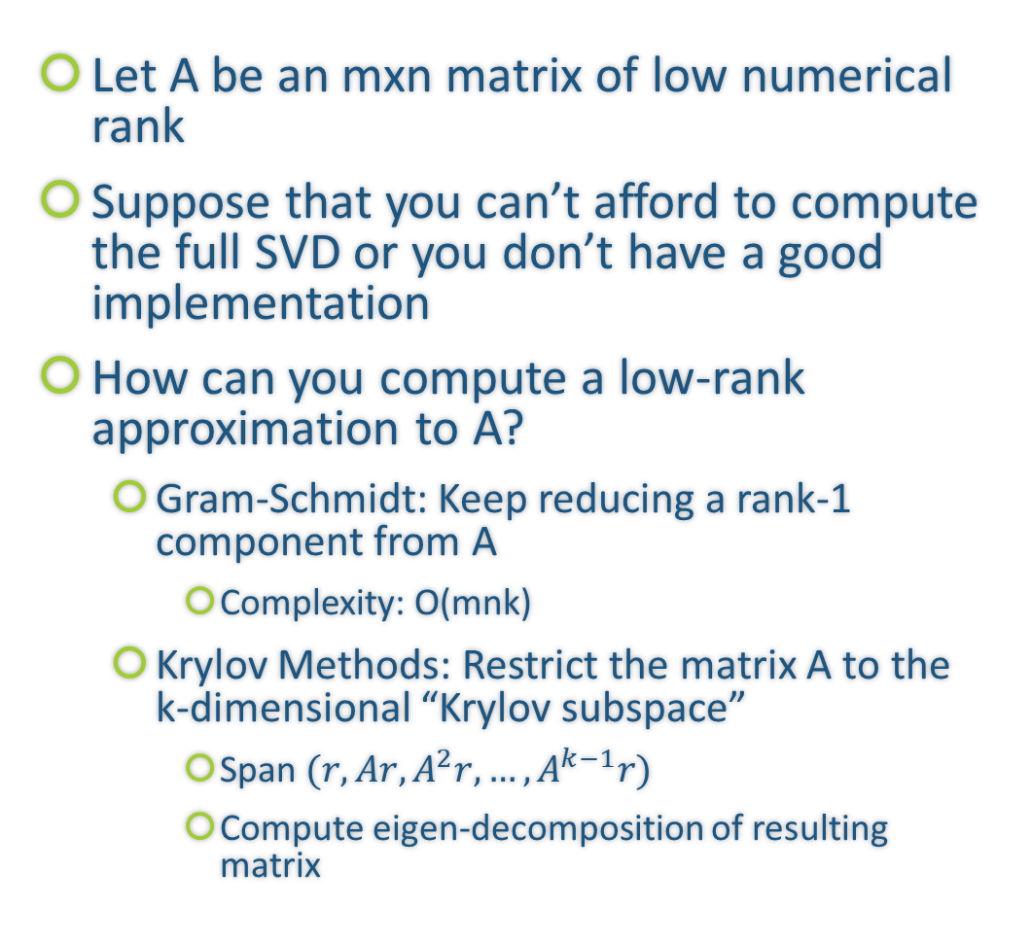
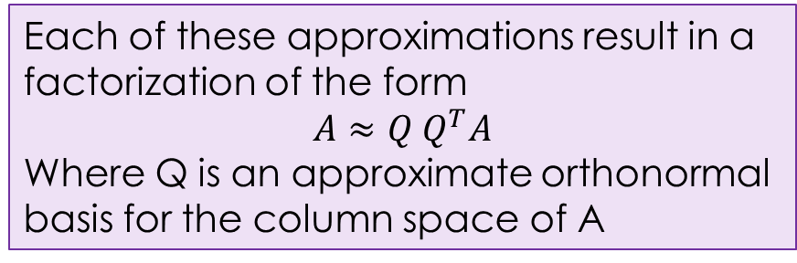
Alternatives to compute Low Rank Approximations
Let A be an mxn matrix of low numerical rank
Suppose that you can’t afford to compute the full SVD or you don’t have a good implementation
How can you compute a low-rank approximation to A?
Gram-Schmidt: Keep reducing a rank-1 component from A
Complexity: O(mnk)
Krylov Methods: Restrict the matrix A to the k-dimensional “Krylov subspace”
Span $(r,Ar, A^{2}r, …,A^{k−1}r)$
Compute eigen-decomposition of resulting matrix
Each of these approximations result in a factorization of the form
$$A≈Q Q^{T}A$$
Where Q is an approximate orthonormal basis for the column space of A

Slide 22
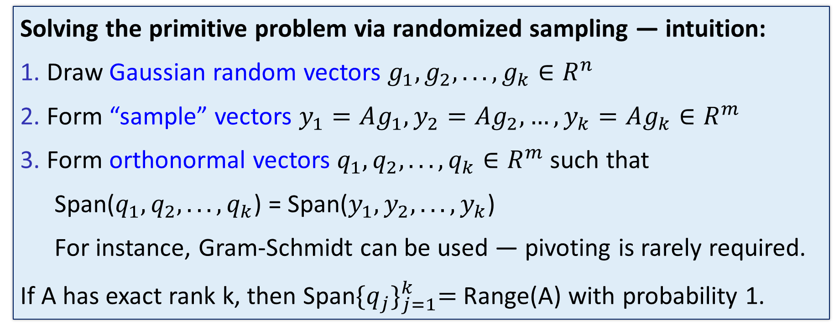
Randomized Low Rank Approximations
Range Finding (Basis) Problem: Given an m x n matrix A and an integer k < min(m,n). Find an orthonormal m x k matrix Q such that$A≈Q Q^{T}A$
Solving the primitive problem via randomized sampling — intuition:
1. Draw Gaussian random vectors $g_{1},g_{2}, . .. , g_{k}∈R^{n}$
2. Form “sample” vectors $y_{1}=Ag_{1},y_{2}=Ag_{2}, …,y_{k}=Ag_{k}∈R^{m}$
3. Form orthonormal vectors $q_{1},q_{2}, . .. , q_{k}∈R^{m}$such that
Span($q_{1},q_{2}, . .. , q_{k}$) = Span($y_{1},y_{2}, . .. , y_{k}$)
For instance, Gram-Schmidt can be used — pivoting is rarely required.
If A has exact rank k, then Span${\{q_{j}\}}_{j=1}^{k}=$Range(A) with probability 1.

Slide 23
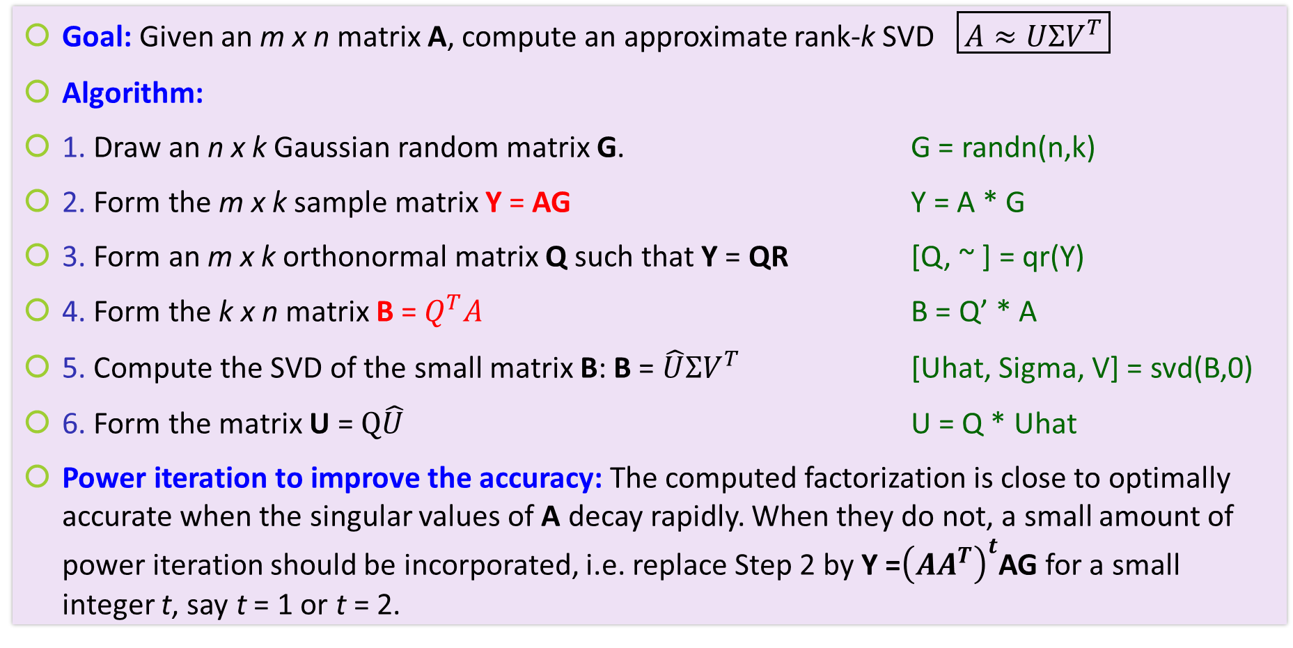
Randomized SVD
Goal: Given an m x n matrix A, compute an approximate rank-k SVD $\boxed{A≈UΣV^{T}}$
Algorithm:
1. Draw an n x k Gaussian random matrix G. G = randn(n,k)
2. Form the m x k sample matrix Y = AG Y = A * G
3. Form an m x k orthonormal matrix Q such that Y = QR [Q, ~ ] = qr(Y)
4. Form the k x n matrix B = $Q^{T}A$ B = Q’ * A
5. Compute the SVD of the small matrix B: B = $\hat{U}ΣV^{T}$ [Uhat, Sigma, V] = svd(B,0)
6. Form the matrix U = $Q\hat{U}$ U = Q * Uhat
Power iteration to improve the accuracy: The computed factorization is close to optimally accurate when the singular values of A decay rapidly. When they do not, a small amount of power iteration should be incorporated, i.e. replace Step 2 by Y =${\left(AA^{T}\right)}^{t}$AG for a small integer t, say t = 1 or t = 2.

Slide 24
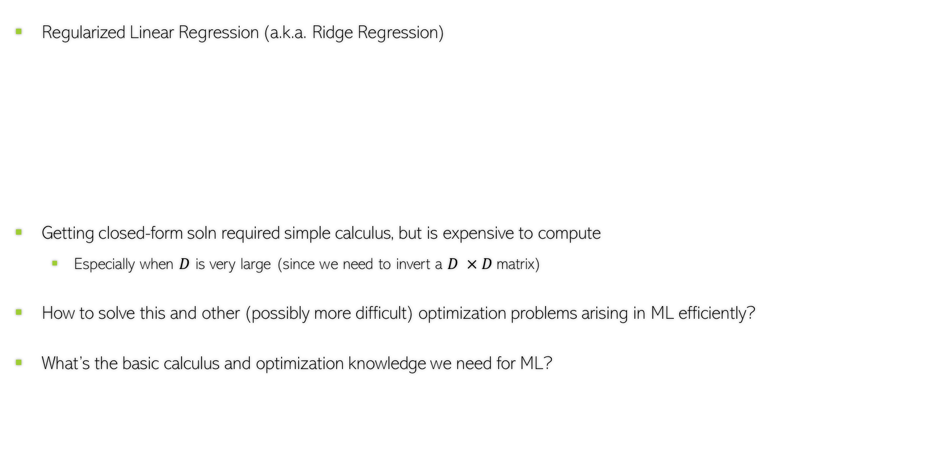
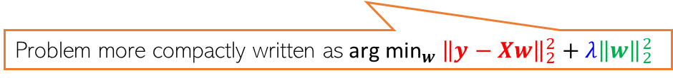
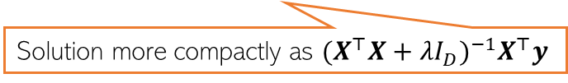
Calculus and Optimization for ML
24
Regularized Linear Regression (a.k.a. Ridge Regression)
Getting closed-form soln required simple calculus, but is expensive to compute
Especially when $D$ is very large (since we need to invert a $D ×D$matrix)
How to solve this and other (possibly more difficult) optimization problems arising in ML efficiently?
What’s the basic calculus and optimization knowledge we need for ML?
$w_{ridge}\text{=}{ \text{arg} \text{min}}_{w}\sum_{n=1}^{N}{{(y_{n}−w^{⊤}x_{n})}^{2}}+λw^{⊤}w={\left(\sum_{n=1}^{N}{x_{n} x_{n}^{⊤}+λI_{D} }\right)}^{−1}$ $(\sum_{n=1}^{N}{y_{n}}x_{n})$
Problem more compactly written as${ \text{arg} \text{min}}_{w} {\left\|y−Xw\right\|}_{2}^{2}+λ{\left\|w\right\|}_{2}^{2}$
Solution more compactly as ${(X^{⊤}X+λI_{D})}^{−1}X^{⊤}y$

